Slide 1


Arduino Workshop: making interactive system with Laptop
GreenLab Microfactory feat. Yuji Ogawa

Slide 2



ABOUT ME!
Social Anthropologist of Technology, and tech enthusiast
From Tokyo, Japan!

Slide 3

SOME OF MY WORKS
Drawing Program using Arduino and Processing

Slide 4

SOME OF MY WORKS
Drawing Program using Arduino and Processing

Slide 5
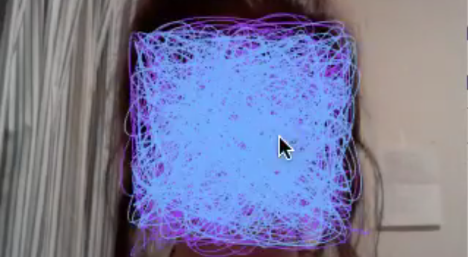
SOME OF MY WORKS
Face detection & Drawing Program using Arduino and openFrameworks

Slide 6
TODAY’S FLOWCHART
1. Learn the basics about Arduino and Robots
2. Learn the difference between analog and digital 3. Analog control of servo motor with potentiometer 4. Analog control of servo motor with mic and Processing 5. Making simple robot!

Slide 7

Today’s goal: The simple version of “Talkie Walkie” (2009, by Guilherme Martins)

Slide 8
TODAY’S FLOWCHART
1. Learn the basics about Arduino and Robots
2. Learn the difference between analog and digital 3. Analog control of servo motor with potentiometer 4. Analog control of servo motor with mic and Processing 5. Making simple robot!

Slide 9
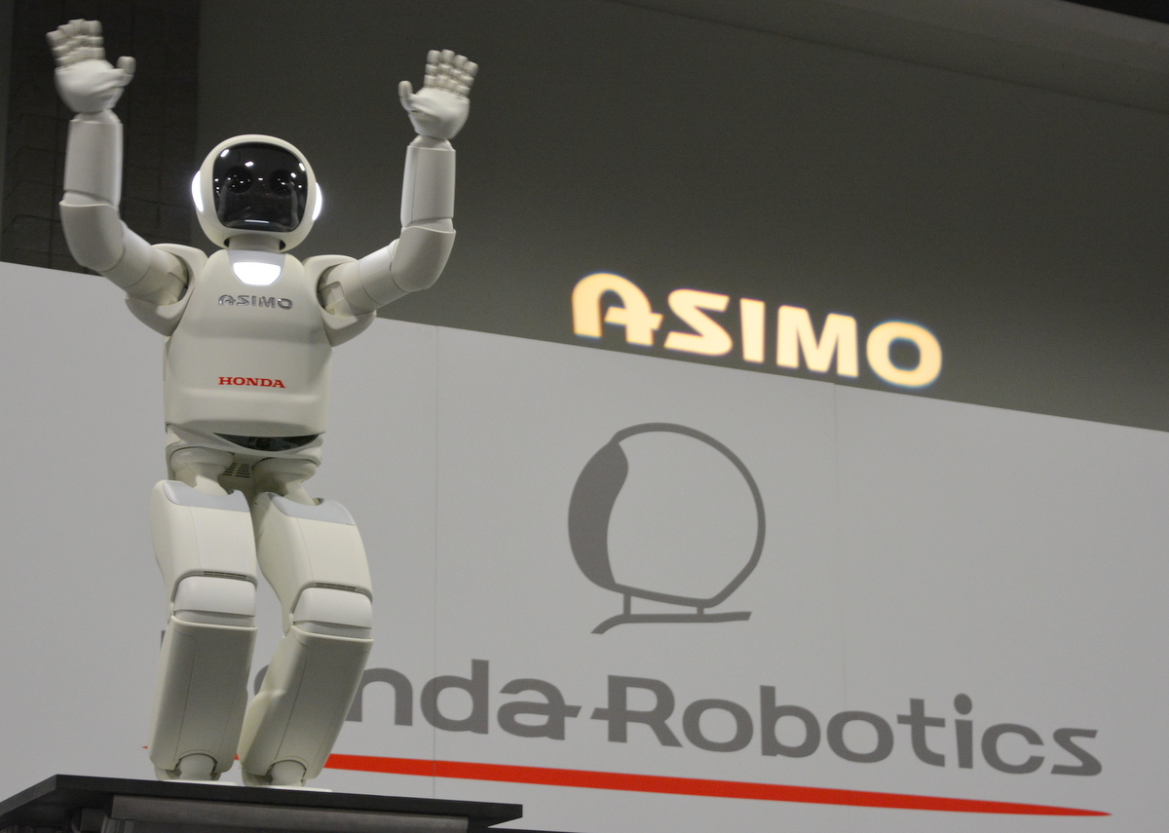
The Robots in Japan…
ASIMO (Honda Robotics) 2000-2018

Slide 10
Why robots are needed?
・To help our lives, obviously. ・For today, we are making a robot for entertainment (which is important to our life, right?)
・BUT, it is important to connect us with the robot. →INTERACTIVITY between machine and our world is necessary for it!

Slide 11
How to make simple robots using handy computer technology
It is very tricky and expensive to build the advanced robot.
BUT STILL, you can start your own robot making by yourself using Arduino.
Arduino is very handy set of micro-controller and IDE (Integrated Development Environment)

Slide 12
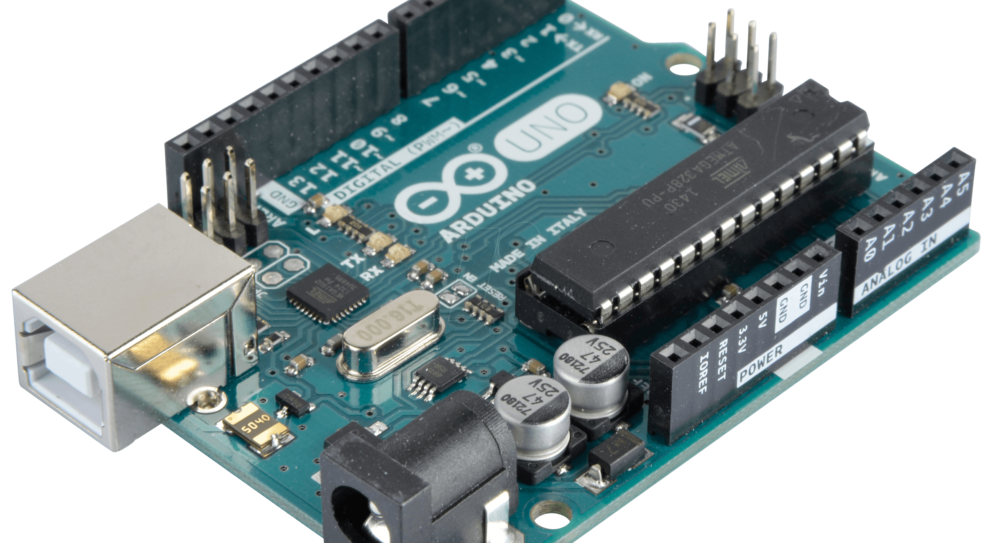
Arduino

Slide 13
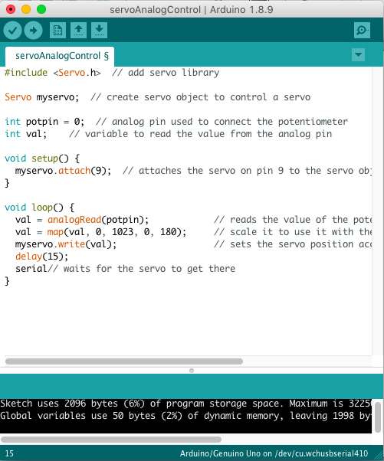

Arduino IDE
I ntegrated D evelopment E nvironment

Slide 14
TODAY’S FLOWCHART
1. Learn the basics about Arduino and Robots
2. Learn the difference between analog and digital 3. Analog control of servo motor with potentiometer 4. Analog control of servo motor with mic and Processing 5. Making simple robot!

Slide 15
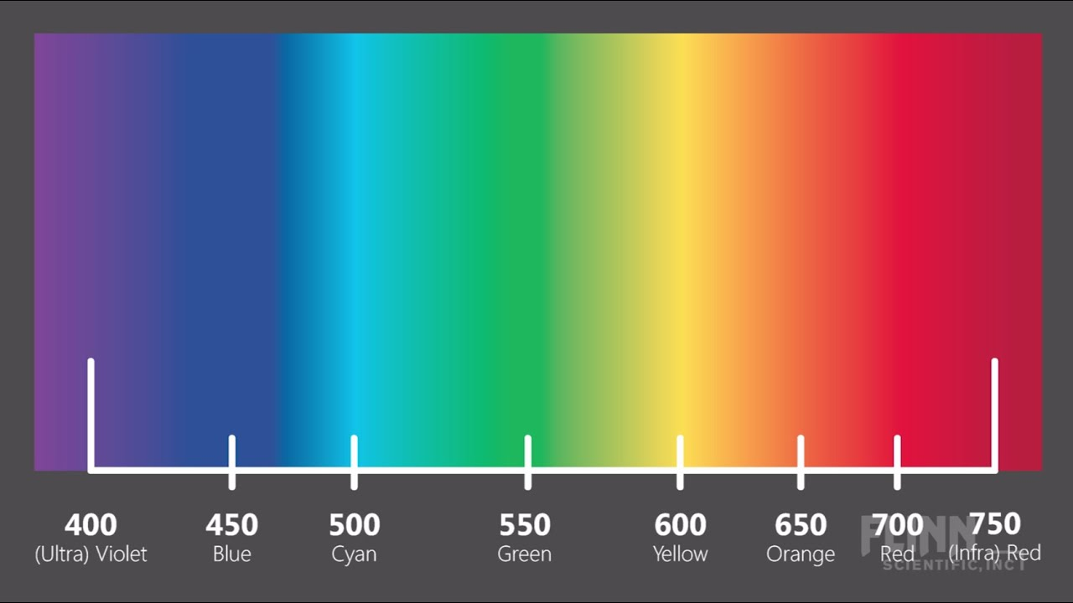
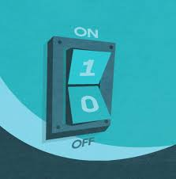
Analog and Digital
ANALOG : a range of continuous data
E.g. 0-255 (color code)
DIGITAL : On and Off, 0 and 1
Just like the light switch!

Slide 16
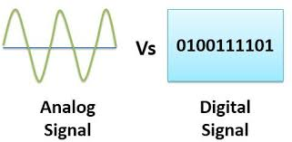
Analog and Digital

Slide 17
Why analog data is important?
・Because: THE REAL WORLD IS NOT MADE OF 0 and 1, on and off, true and false.
→THEN: you have to use ANALOG data too, for making robot interactive with our world.
→We will utilise analog data to control the machine.

Slide 18
TODAY’S FLOWCHART
1. Learn the basics about Arduino and Robots
2. Learn the difference between analog and digital 3. Analog control of servo motor with potentiometer 4. Analog control of servo motor with mic and Processing 5. Making simple robot!

Slide 19
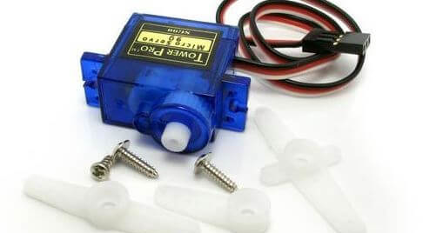
Micro servo motor
・Servo motor is one of the motors whose rotation can be controlled.
・The rotation can be controlled from 0° to 180° degrees.

Slide 20
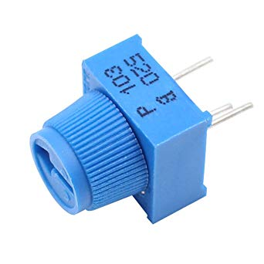
Example #1
・After you get the meaning of analog control and servo motor… Let’s control the servo with potentiometer.

Slide 21
Potentiometer
Potentiometer: “a three-terminal resistor with a sliding or rotating contact that forms an adjustable voltage divider.” → in short “analog variable setter.” →We are going to use it to control the servo motor.

Slide 22
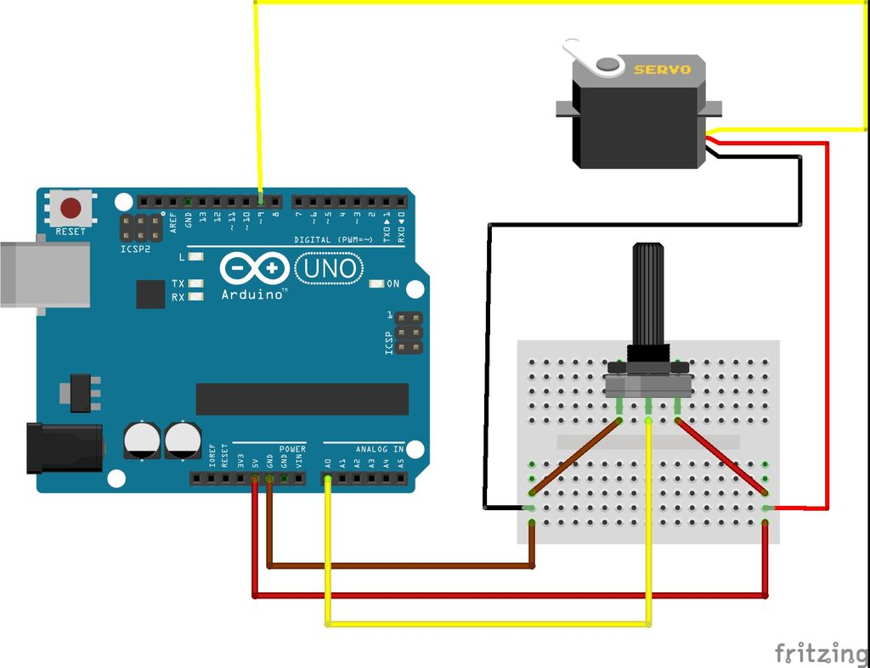
Circuit

Slide 23
Arduino Code (1)
#include <Servo.h> // add servo library
Servo myservo; // create servo object to control a servo
int potpin = 0; // analog pin used to connect the potentiometer
int val; // variable to read the value from the analog pin
void setup() {
myservo.attach(9); // attaches the servo on pin 9 to the servo object
}

Slide 24
Arduino Code (2)
void loop() {
val = analogRead(potpin);
// reads the value of the potentiometer (value between 0 and 1023)
val = map(val, 0, 1023, 0, 180);
// scale it to use it with the servo (value between 0 and 180)
myservo.write(val);
// sets the servo position according to the scaled value
delay(15); // waits for the servo to get there
}

Slide 25
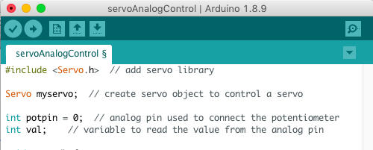
Uploading the code to Arduino
Connect Arduino to Laptop with USB
→ Press Upload ( ) button

Slide 26
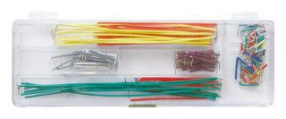
How to Wire (1)
・ 5V pin on Arduino → “+” on breadboard
・GND pin on Arduino → “-” on breadboard
Jumper Wire

Slide 27
How to Wire (2)
・Connect potentiometer to breadboard
・Right pin of potentiometer → “+” on breadboard
・Left pin of potentiometer → “-” on breadboard
・Center pin of potentiometer → A0 on Arduino
+
A0
-

Slide 28
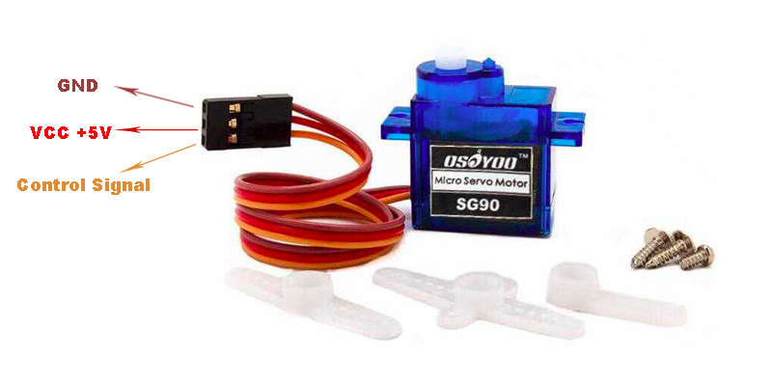
How to Wire (3)
・Orange wire of servo motor → D9 on Arduino
・Red wire of servo motor → “+” on breadboard
・Brown wire of servo motor → “-” on breadboard

Slide 29
TODAY’S FLOWCHART
1. Learn the basics about Arduino and Robots
2. Learn the difference between analog and digital 3. Analog control of servo motor with potentiometer 4. Analog control of servo motor with mic and Processing 5. Making simple robot!

Slide 30



Example #2
Let’s connect the servo motor with Processing, and make it interactive with sound.

Slide 31
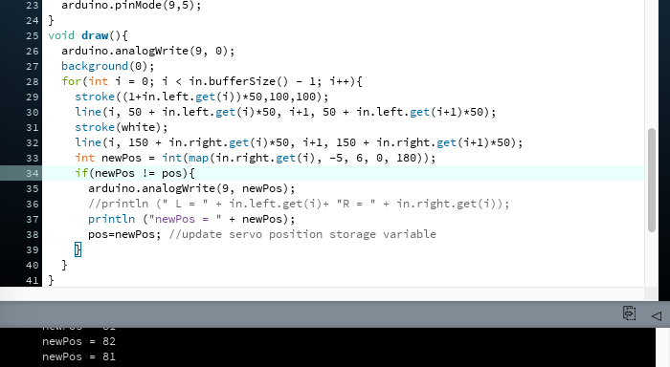
Processing

Slide 32
Firmata
・Firmata: “a generic protocol for communicating with microcontrollers from software on a host computer.“ →Simply, the library which enables easy serial communication between Arduino and Laptop.
・To open Firmata: Arduino -> File -> Examples -> Firmata -> StandardFirmata
→Upload them as we did!

Slide 33
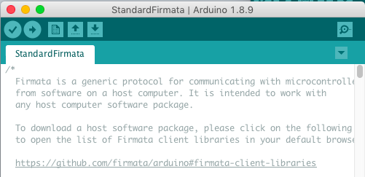
Uploading Firmata to Arduino
Connect Arduino to Laptop with USB
→ Press Upload ( ) button

Slide 34
Processing Code
import processing.serial.*;
import cc.arduino.*;
import ddf.minim.*;
Arduino arduino;
Minim minim;
AudioInput in;
color white;
int pos = 80;

Slide 35
void setup(){
size(512, 200, P2D);
white = color(255);
colorMode(HSB,100);
minim = new Minim(this);
minim.debugOn();
in = minim.getLineIn(Minim.STEREO, 1024);// get a line in from Minim, default bit depth as 16
background(0);
arduino = new Arduino(this, Arduino.list()[2], 57600); //your offset may vary
arduino.pinMode(9,5);
arduino.analogWrite(9, pos); //calibration
}

Slide 36
void draw(){
background(0);
for(int i = 0; i < in.bufferSize() - 1; i++){
stroke((1+in.left.get(i))*50,100,100);
line(i, 50 + in.left.get(i)*50, i+1, 50 + in.left.get(i+1)*50);
stroke(white);
line(i, 150 + in.right.get(i)*50, i+1, 150 + in.right.get(i+1)*50);
int newPos = int(map(in.right.get(i)*2, -5, 2, 60, 160));
println ("Pos = " + newPos);
if (newPos != pos){
arduino.analogWrite(9, newPos);
pos=newPos;
}
}
}

Slide 37
Processing Code (contd)
void stop(){
// always close Minim audio classes when you are done with them
in.close();
minim.stop();
super.stop();
}

Slide 38
How to Wire (1)
・ 5V pin on Arduino → “+” on breadboard
・GND pin on Arduino → “-” on breadboard
Jumper Wire

Slide 39
How to Wire (2)
・Orange wire of servo motor → D9 on Arduino
・Red wire of servo motor → “+” on breadboard
・Brown wire of servo motor → “-” on breadboard

Slide 40
TODAY’S FLOWCHART
1. Learn the basics about Arduino and Robots
2. Learn the difference between analog and digital 3. Analog control of servo motor with potentiometer 4. Analog control of servo motor with mic and Processing 5. Making simple robot!

Slide 41

Example #3… Robot!

